Slide 1
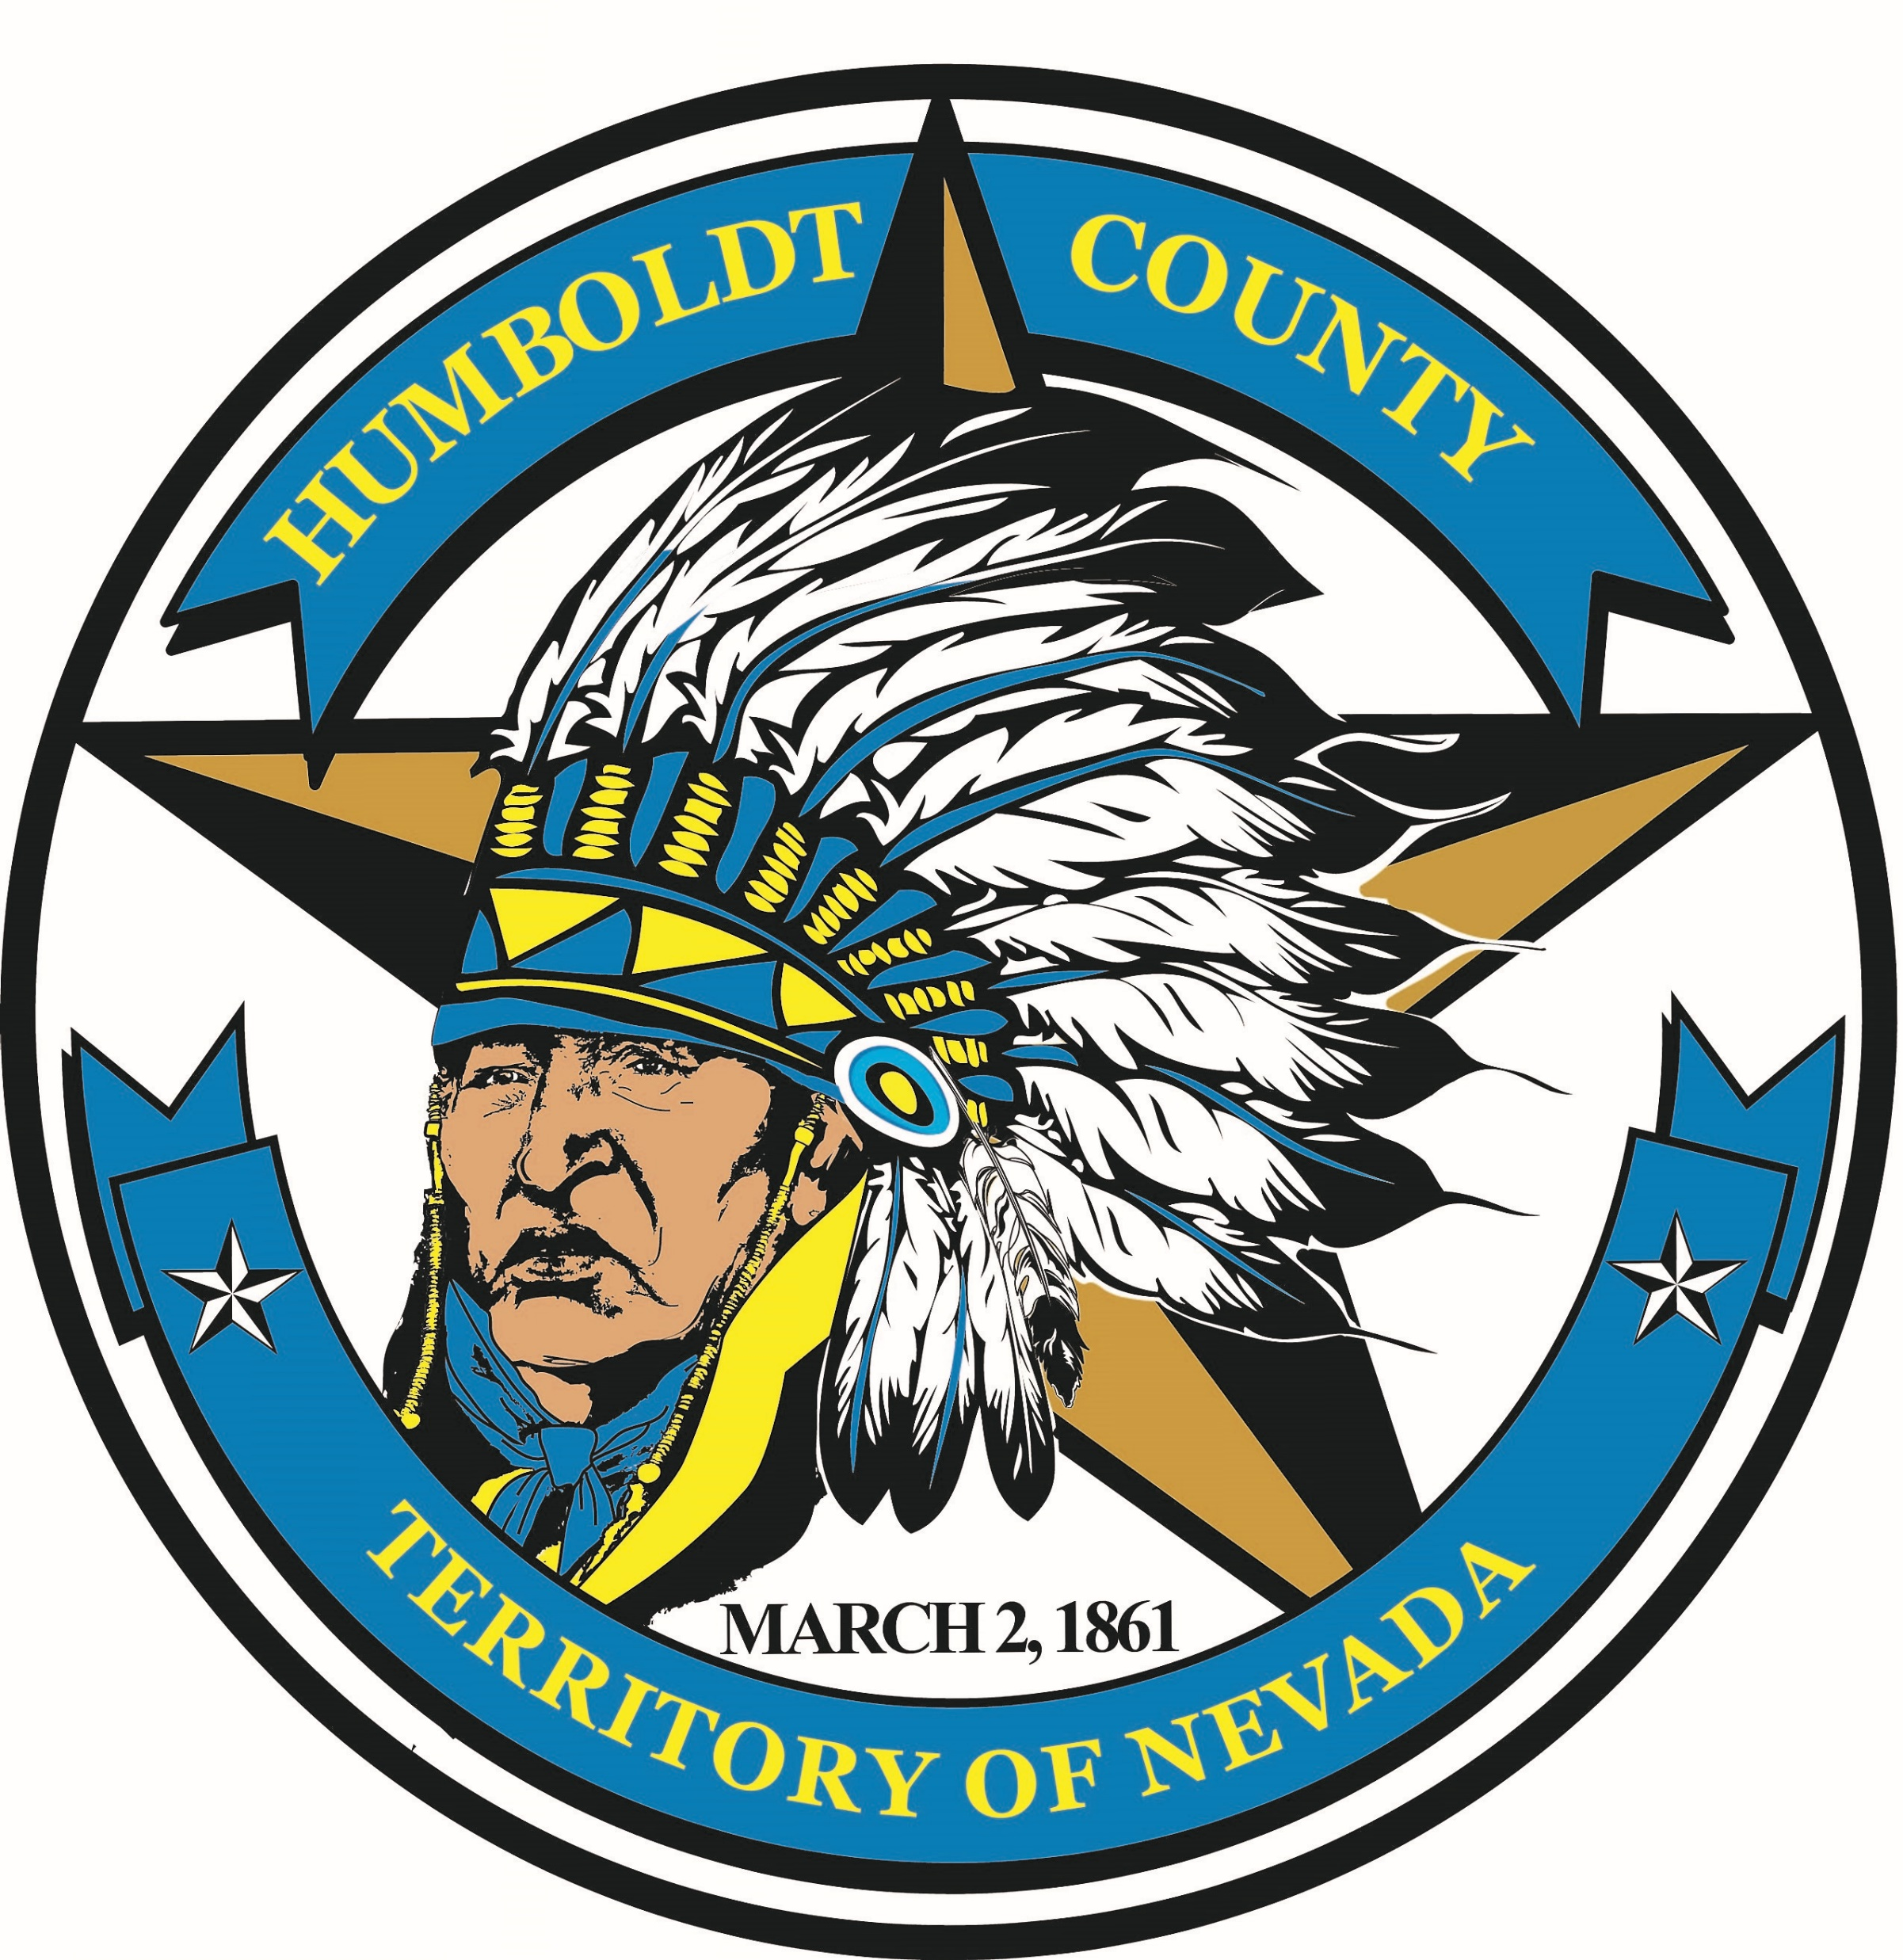
Nitrate Mitigation Plan & Gold Country Water Acquisition
January 25, 2021
Humboldt County Commission
Annual Retreat

Slide 2
Recent History of Grass Valley Nitrate
12/2014: Dave Mendiola hired to be County Manager
02/2015: Grass Valley Resident appears before the Commission asking what plans the county has for mitigating the growing issue with Nitrates (EPA Max. Standard is 10ppm-Wells reading at 3-5ppm and rising annually)
04/2015: County Commissioners direct County Manager to look into possible solutions for Nitrate issues in Grass Valley.
04/2015: Star City Property Owners Association approach county to acquire water system as Board members are impossible to come by and operators want to retire. This process started some years earlier.
04/2015: Gold Country Water expresses interest in acquiring Star City from County after they acquire system.

Slide 3
Recent History of Grass Valley Nitrate
11/2016: County Approves Source Water Protection Plan to address water quality issues throughout county-Emphasis on Grass Valley Nitrates and McDermitt Arsenic.
09/2020: County acquires Star City Water System
01/2021: County submits application to SRF for Preliminary Engineering Report to extend City of Winnemucca Waste Water pipeline and connect residents of Star City to city sewer system through SRF funding.

Slide 4
What’s The Urgency?
Nitrate Levels continue to rise in Grass Valley. The County, Star City and Gold Country wells continue to show increases in nitrates due to the large numbers of Septic Systems in Grass Valley
County Manager has discussed his vision for starting the process to mitigate the issue by extending the city of Winnemucca waste water pipeline to Star City and hook up homes in that water district with State funding.
Part of that vision is to acquire Gold Country and use state funding to hookup a sewer system for those residents and eventually build a Waste Water Treatment facility in Grass Valley.
We cannot kick this down the road any longer and local government is the only organization capable of getting this done both from an organizational and funding (access to non-taxable loan and grants) perspective.

Slide 5
Gold Country History
Established in early 1980’s by Baum and Calder families
Water service extended to Grass Valley Elementary School in mid 1980s
Development of the subdivision grew steadily from the mid 1980s through 2000 and water service was extended to Baptist and LDS churches.
County considers acquiring Gold Country Water in 1999-Negotiations fail
Service was also provided to numerous residential lots in Thomas Canyon Estates. By year 2000 system served 325 customers
In 2001 the Baum (operators of the water system) and Calder families sold GC to Foree, Peterson and Shaw

Slide 6
Gold Country History Continued…..
In 2008 Gold Country took out Loan #1 ($376,000) with the State Revolving Fund (SRF) primarily to install meters, rebuild the booster pump station and install chlorination – Gold Country customers pay a surcharge of $3.90 per month for the debt service for this loan (term 20 years, interest rate is 3.43%)
The nitrate level in Well 1 began rising steadily beginning about 2006.

Slide 7
Gold Country History Continued…..
In 2011, the nitrate level in Well 1 exceeded the maximum contaminant level (MCL) of 10 parts per million – Gold Country took out Loan #2 ($705,000) from the SRF for nitrate mitigation – GC customers began paying a surcharge of $10.63 per month for this nitrate mitigation loan (term is 20 years, interest rate is 3.68%).
Well 1 nitrate level increased to 20 ppm in 2019.
Instead of drilling replacement well, Gold County negotiated an agreement with the City of Winnemucca to purchase the Airport Industrial Park water system including two wells. City maintains water rights.
Primary improvements related to the consolidation of the two systems (Airport and GC) were completed in 2012 and the two systems began operating as one

Slide 8
Gold Country History Continued…..
In 2015 Gold Country agreed with Star City to pay for and install an interconnection between the two systems at Grass Valley Road and Mary Way to improve system reliability and redundancy for both systems
In 2017 the nitrate level in Gold Country’s Well 2 began rising steadily from 1.3 ppm in April of 2017 to 7.4 in October of 2020 and it is expected to exceed the MCL within the next few years which requires further nitrate mitigation
GC applied for a grant from the SRF to study nitrate mitigation in December 2020. This grant is up for approval at the SRF’s January 20, 2021 meeting.

Slide 9
Benefits of Consolidation with Star City....
EPA through the State Revolving Fund (SRF) currently has grant monies available for consolidation of water systems which are typically used for government water systems to acquire private water systems (that are typically underfunded and cannot access grant funds without significant tax liability).
While grant funding is available today, it may or may not be available in the future, or it could be available but at a lower level
EPA funds these consolidation grants to improve reliability and redundancy of water service to customers, improve water quality, etc.
With an SRF principal forgiveness (grant) HC likely could acquire the GC water system at no cost to HC.
GC customer paid debt could be refinanced at a much lower rate, saving approximately $60,000 over the remaining life of the loans and reducing the debt service by about $1,000 per month in the first year

Slide 10
Benefits of Consolidation with Star City....
Since both Star City and Gold Country wells have rising nitrate levels and both are likely to exceed the maximum contaminant level within the next few years, there is likely a solution that would benefit both systems by using SRF grant funding.
With a government system, new development costs are much lower due to not having to pay taxes, while private systems have to pay taxes on developer built and dedicated facilities, i.e. water main extensions, and have to pass those (tax liability) costs on to the developer.
If personnel issues are a concern for short and long-term maintenance, contracting operations is possible at a reasonable cost which could include training HC employees (Through Gold Country)

Slide 11
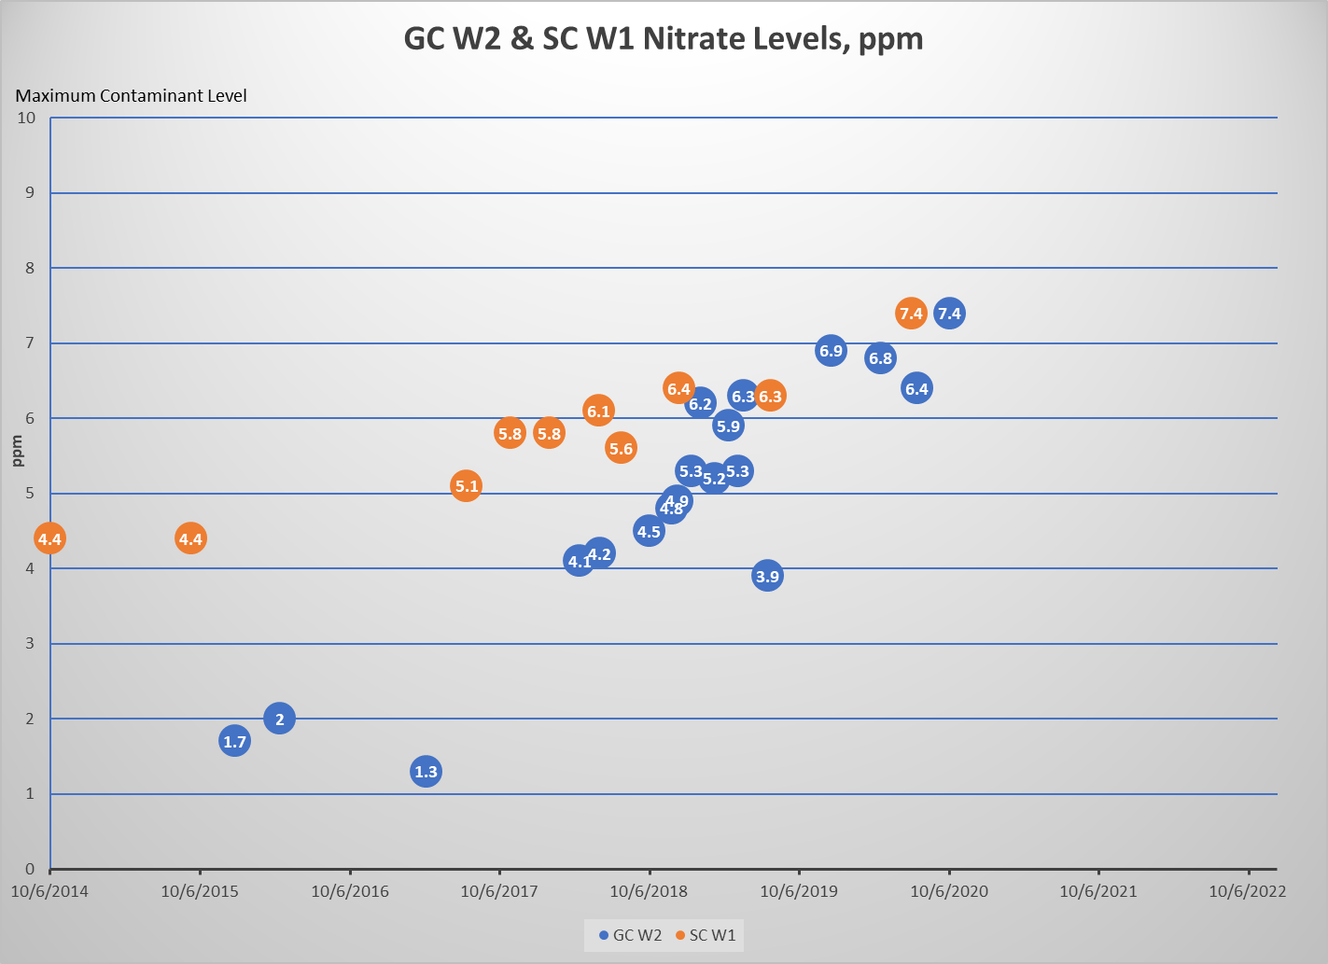
Nitrate Levels Gold Country & Star City

Slide 12
Why did Gold Country have a change of heart to acquire Star City?
Over the years, the Public Utilities Commission of Nevada (PUCN) has changed course on its treatment of private water systems and it has become exceedingly difficult for private systems to operate.
For example, contributed assets including distribution mains are taxable, so any developer built and dedicated infrastructure would need to be grossed up by 35% or more for income tax liability in accordance with PUCN requirements
This is not applicable to government owned water systems as they are not subject to taxes. This is very significant for new development in a growing area.

Slide 13
What is the best course of action?
The county commission needs to approve a feasibility study to look at all of the variables and possible solutions to begin the process of mitigating nitrate levels in Grass Valley
A feasibility study will assist in providing a path forward, the costs associated with any action and possible funding sources.
While my sense is acquiring Gold Country should be a part of those solutions, it is best we get a professional opinion to support that decision.
This will also provide the Commissioners the “big” picture to assure that any action taken will be good now and for the long-term.

