Slide 1
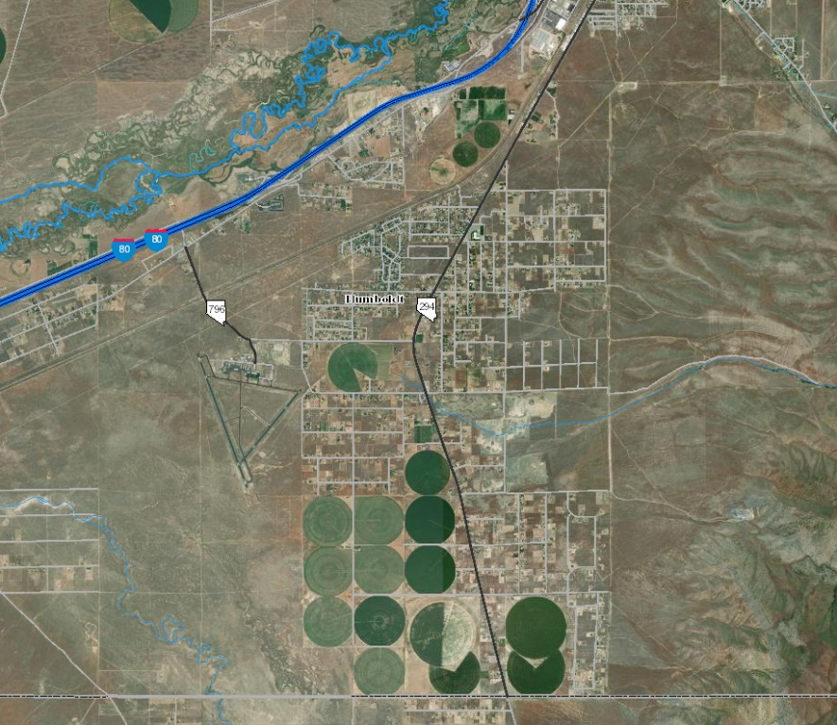
Grass Valley Sewer PER
Findings and Recommendations

Slide 2
Preview
Farr West prepared preliminary engineering report (PER) at the request of Humboldt County to consider how to address the elevated nitrate levels in Grass Valley’s groundwater aquifer due to septic discharge.
The PER delineates the density of septic systems operating in Grass Valley are a direct contributor to the elevated nitrate levels.
The scope of the PER includes a collection system and three action alternatives and one no action alternative. The no action alternative was determined to not be a sustainable solution and is therefore not a part of this presentation.
The recommendation of the report is to construct a Humboldt County owned / operated collection system & mechanical treatment facility.

Slide 3
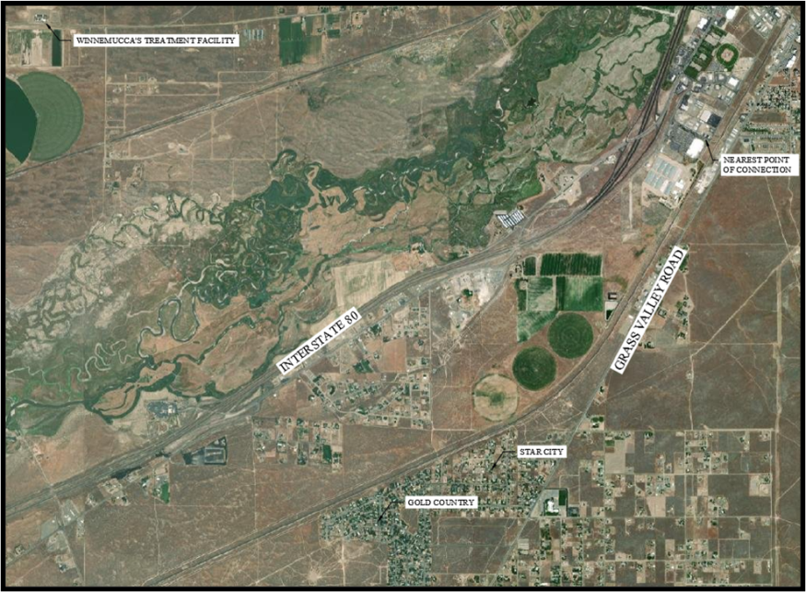
Existing Facilities
Grass Valley residents and businesses are reliant on septic systems for collection and treatment of their wastewater
Locations with a high density of septic systems along with nearby farming are discharging water into the ground which is impacting the aquifer water quality
The closest wastewater treatment facility is owned and operated by the City of Winnemucca; the nearest connection point is approximately 2 miles northeast from Grass Valley

Slide 4
Completed Studies
Previous reports completed in 1993 concluded the density of septic systems in Grass Valley were negatively impacting the groundwater quality and recommended connection to a wastewater treatment facility
  Additional reports and technical memos were published in 1997, 1998, and 1999, all supporting the need for an alternative to septic systems
In 2012 The Nevada Division of Environmental Protection (NDEP) determined to have a groundwater nitrate assessment study performed
  This study, issued in 2014, was for areas of concern throughout the state including Grass Valley

Slide 5
Need for the Project
The NDEP study noted that 550 letters were sent to individual well owners requesting permission to collect a water samples for the Grass Valley area
  A total of 134 samples were collected and tested in the fall of 2014
Multiple sample results showed exceedances of the maximum allowable contaminant level (MCL) of 10 milligrams/liter (mg/L) for nitrate levels
  This prompted additional testing of the monitoring wells located within Grass Valley.

Slide 6
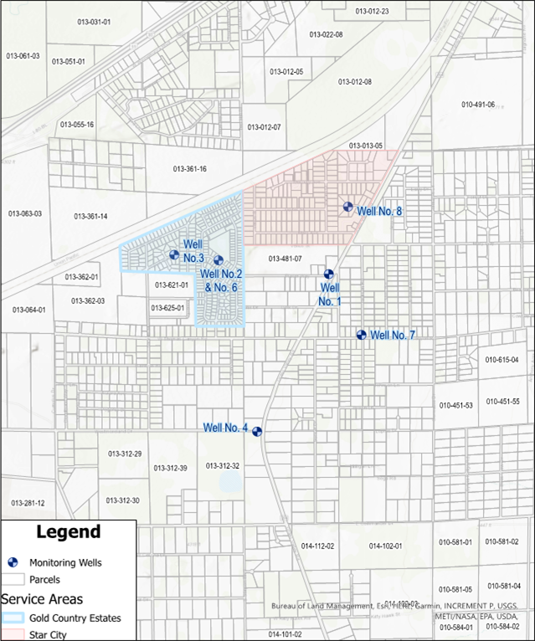
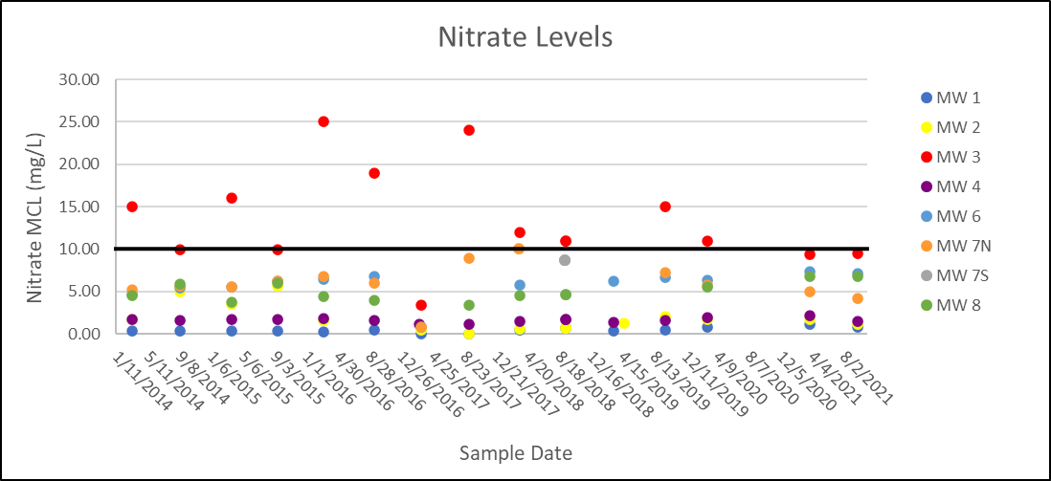
Need for the Project
The monitoring wells shown in the figure were monitored consistently from January 2014 to present day
  Monitoring Well No. 3 and Well No. 7 had nitrate exceedances, as shown below
*Nitrate MCL = 10 mg/L

Slide 7
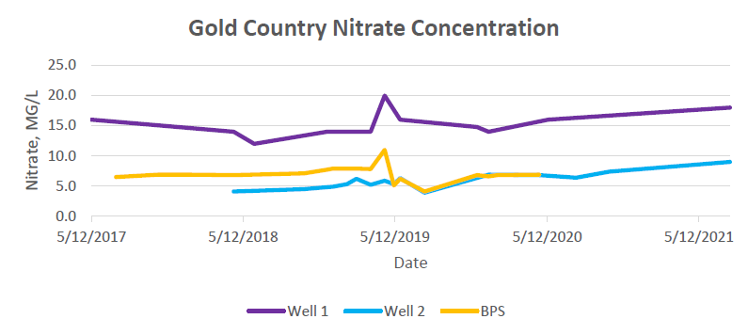
Need for the Project
Gold Country production Wells 1 & 2 samples from May 2017 to May 2021
  Well 1: 12 mg/L to 20 mg/L
  Well 2: 4 mg/L to 9 mg/L
Well 1
Nitrate MCL = 10 mg/L
Well 2
Source: One Water Consulting (March 2021)

Slide 8
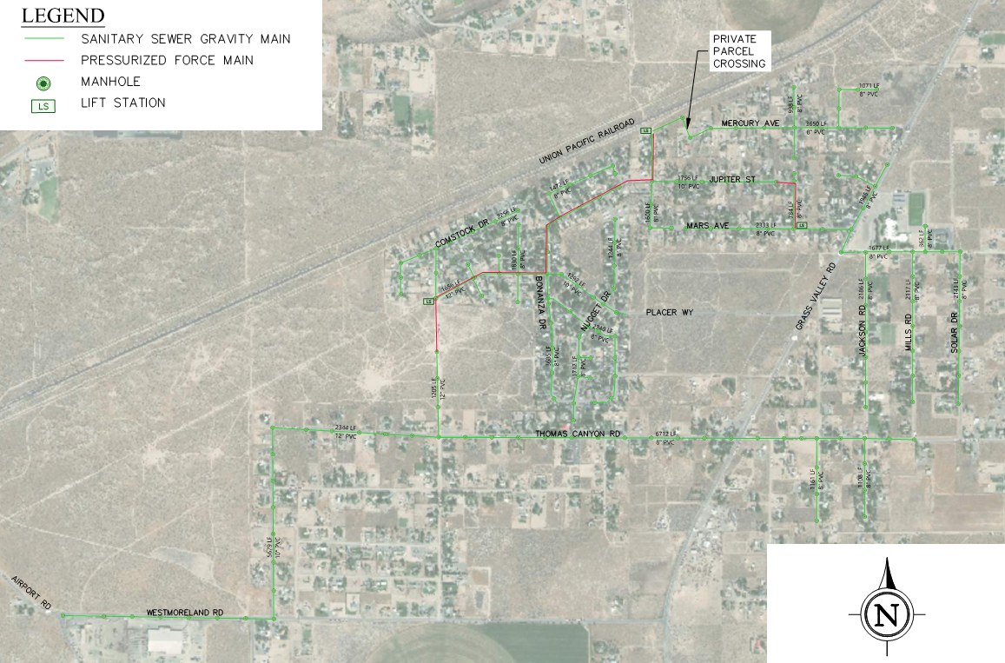
Grass Valley Project Area
The PER scope consists a conversion of septics to a collection system that terminates with a treatment facility
3 alternatives for wastewater treatment were considered:
  Connect to City of Winnemucca Sewer
  Construct a Mechanical WWTF
  Construct WW Treatment Ponds

Slide 9
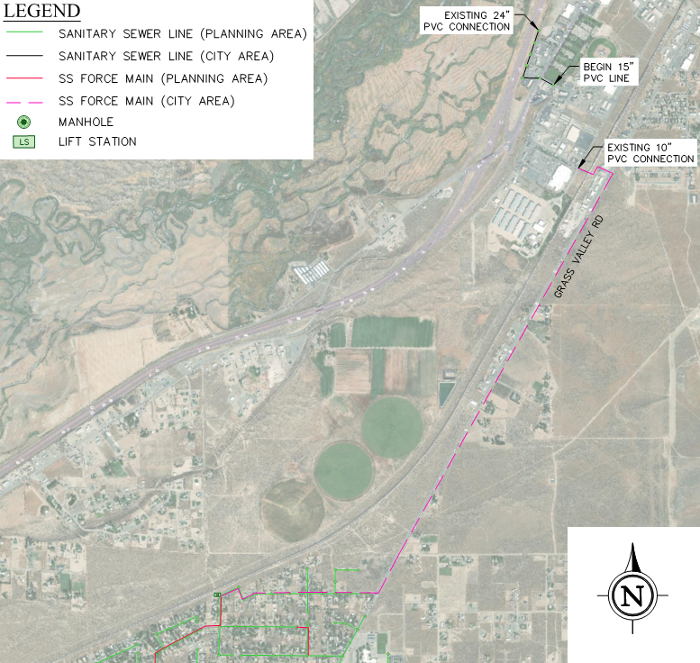
Alternative 1 – Connect to Winnemucca Sewer
System Parameters:
Collection system: 59,000 LF of gravity sewer; 6,300 LF of force main, and 3 lift stations within the project area
An additional 15,800 LF of force main to convey the wastewater to the city connection point
1,900 LF of 15” gravity sewer to be constructed within the city boundary to provide sufficient capacity- limits future expansion
Cost Estimates:
Capital = $28.7 million
Annual O&M = $769,300
*Capital cost includes connection fees due to the
City of Winnemucca; O&M $0.007/gal treated
**Grass Valley residents will have connection and usage fees at 1.5 times the rate of users within the city limits

Slide 10
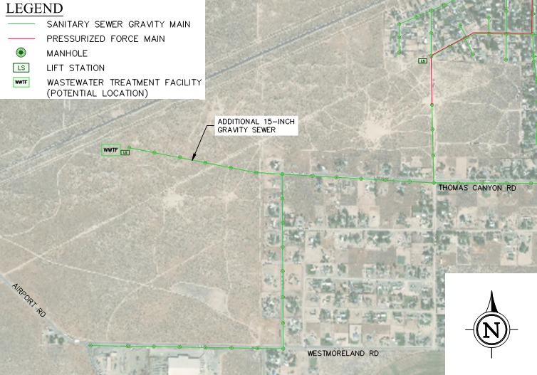
Alternative 2 – Construct Mechanical WWTF
System Parameters:
Collection system: 59,000 LF of gravity sewer; 6,300 LF of force main, and 3 lift stations in the project area
Mechanical Treatment Facility
Rapid Infiltration Basins (RIBs)
Cost Estimates:
Capital = $27.8 million
Annual O&M = $353,700
*Not a part of this study, but water disposal can be accomplished with reuse application

Slide 11
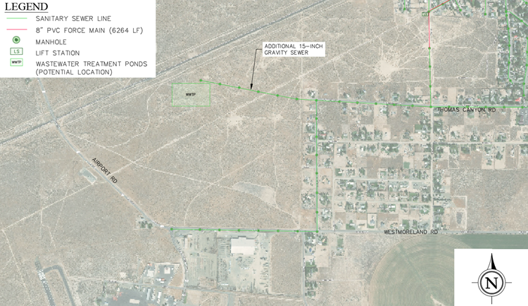
Alternative 3 – Construct Treatment Ponds
System Parameters:
Collection system: 59,000 LF of gravity sewer; 6,300 LF of force main, and 3 lift stations within the project area
Treatment Ponds
Rapid Infiltration Basins (RIBs)
Cost Estimates:
Capital = $23.2 million
Annual O&M = $341,700

Slide 12
Alternative Cost Analysis
Alternative | Capital Cost | Annual O&M Cost | O&M NPV | Total NPV
Alternative 1 – Connect to City of Winnemucca Sewer | $28,713,700 | ($769,300) | $16,993,600 | $45,707,300
Alternative 2 – Mechanical WWTF | $27,796,200 | ($353,700) | $7,813,100 | $35,582,300
Alternative 3 – Treatment Ponds | $23,244,300 | ($341,700) | $7,548,000 | $30,792,300
*O&M NPV considered a period of 20 years and a discount rate of -0.5%
Alternative 3 appears to be the most cost-effect solution based on net present value; however, it does not provide opportunity for growth in Grass Valley
As need for capacity increases, treatment ponds would likely be replaced by mechanical treatment
Treatment ponds do not remove nitrates as effectively as mechanical treatment

Slide 13
Non-Monetary Alternative Comparison
Non-Monetary Factor | Alternative 1 Connect to Winnemucca Sewer | Alternative 2 Construct a Mechanical WWTF | Alternative 3 Construct Treatment Ponds
Constructability | 2 | 4 | 3
Flexibility | 3 | 1 | 2
Long-Term Feasibility | 3 | 1 | 2
Ease of Operation | 2 | 4 | 3
Reliability | 3 | 2 | 1
Environmental Impact | 1 | 2 | 3
Land Requirement | 2 | 3 | 4
Master Planning Emphasis | 3 | 1 | 2
Overall Score | 19 | 18 | 20
Alternative 2 (lowest value) provides the best score for the considered factors because it has a greater flexibility to comply with regulations, long-term ability to adapt to growth in Grass Valley, and best meets goals outlined in the Humboldt County Master Plan to protect groundwater resources.

Slide 14
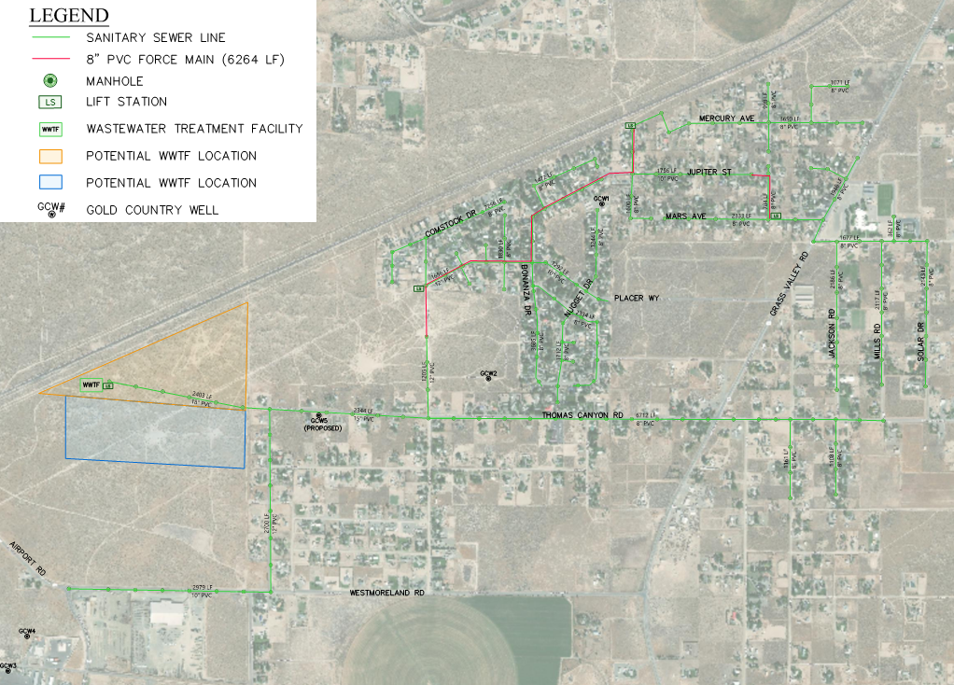
Recommended Alternative
Construct a county owned and operated treatment facility consisting of the following:
  Collection system as previously described with gravity sewer, force main, and at least 3 lift stations
  Mechanical treatment facility
  Rapid infiltration basins (RIBs) to collect effluent discharged from the WWTF to be filtrated back into the ground water aquifer
A preliminary environmental assessment concluded this proposed project would have no significant adverse impacts on the environment or habitations

Slide 15
Engineer’s Opinion of Probable Cost
Construction and material cost estimates provided in this preliminary report are made based on recent construction costs of similar items
  The actual construction bid is expected to vary from the estimate provided here due to changing economic factors
As the design is finalized and the project is prepared for bids a more precise estimate will be determined
Project Component | Cost
WWTF Construction | $ |  | 5,065,600
Electrical Systems | $ |  | 788,300
Collection System Construction | $ |  | 15,615,200
Lift Stations | $ |  | 705,000
Non-Construction Costs | $ |  | 5,622,100
Total | $ |  | 27,796,200
Annual Operations and Maintenance
Salaries & Benefits | $ | 142,000
Chemicals | $ | 38,000
Short Lived Asset Maintenance/Replacement | $ | 10,400
Administrative & Support Services | $ | 26,400
Energy Cost | $ | 69,000
Sludge Disposal Hauling Equipment | $ | 36,000
Sludge Disposal Fee | $ | 30,000
Annual Discharge Permit Fee | $ | 1,900
Annual Operation Cost Total | $ | 353,700

Slide 16
Budget Example
$1.1 million financed at a 2.275% interest rate with a 20-year term, approximately 96% of the project funded with principal forgiveness
Reserve account, based on annual payment amount, allows for a 10-year cumulation of funds
Residential service fees would be charged at $55 per month
Commercial service fees are charged at 2.5 times the residential rate, $137.50 per month
Operational Item | Cost
Revenue Generated from Service Fees | $ | 432,600
Annual Loan Payment | $ | (69,500)
Annual Reserve Payment | $ | (7,000)
Annual O&M Cost | $ | (353,700)
Annual Balance of Funds | $ | 2,500

Slide 17
Recommendations
Feedback as we pursue the proposed project as outlined in the previous slides
Need to continue to inform the public of the current and potential health risks associated with elevated nitrate levels and obtain public feedback
Consider easements, land leases or purchases, and permits as required for construction
Start the project as soon as financially allowable for the benefit of the public’s health and to reduce further degradation to the groundwater aquifer

